Slide 1
TERM 4
LIFE SKILLS
GRADE 2 YEAR 1 & 2

Slide 2
LESSON PLAN CONTENT
WEEK 1-2 | WATER
WEEK 3-5 | OUR COUNTRY SOUTH AFRICA
WEEK 6-7 | COMMUNICATION IN OUR WORLD
WEEK 8-9 | LIFE AT NIGHT

Slide 3
Lesson objectives
Learners will be able to…
Years 1&2
Discuss the water cycle
Save water
Know the name of our country South Africa
Recognise the map of South Africa
Recognise the symbols of South Africa
Name own province and town
Recognise the South African flag and places where we can see it flying. Meaning of colours
Listen/hum/sing South African

Slide 4
Lesson objectives cont.…
Identify common communication skills
Identify common communication technologies
Identify ways that a person’s privacy and reputation may be compromised online
Identify examples of texting style language, including abbreviations and emoticons.
Describe the appropriate and inappropriate uses of texting style language.
Describe some potential consequences of the inappropriate use of texting style language
Discuss things they do at night get ready for bed, read and tell stories, sleep and dream
Identify people who work at night - such as security officers, doctors, pilots, truck drivers
Identify night animals - such as owls, hamsters, porcupines, leopards, jackal

Slide 5
ASSESSMENT GOALS
Year 1
Show and match pictures to the water cycle
Understand water must be saved and give examples
Recognise how water purification works
Understand water must be saved and give examples
Know the name of our country
Recognise the map of South Africa and name the symbols of South Africa
Select the South African flag and respond to the anthem.
Identify different communication skills
Identify different communication technologies and give examples
Discuss and explain things or events we do at night - get ready for bed, read and tell stories, sleep and dream
Year 2
Know and discuss the water cycle using basic vocabulary
Know how to save water
Know and explain how water purification works
Know the province of residence and town of residence
Know and label the flag and the meaning of the colours
Know and sing/hum the anthem
Understand the term rainbow nation
Identify ways that a person’s privacy and reputation may be compromised online.
Identify examples of texting-style language, including abbreviations and emoticons.
Describe and discuss the appropriate and inappropriate uses of texting-style language.

Slide 6
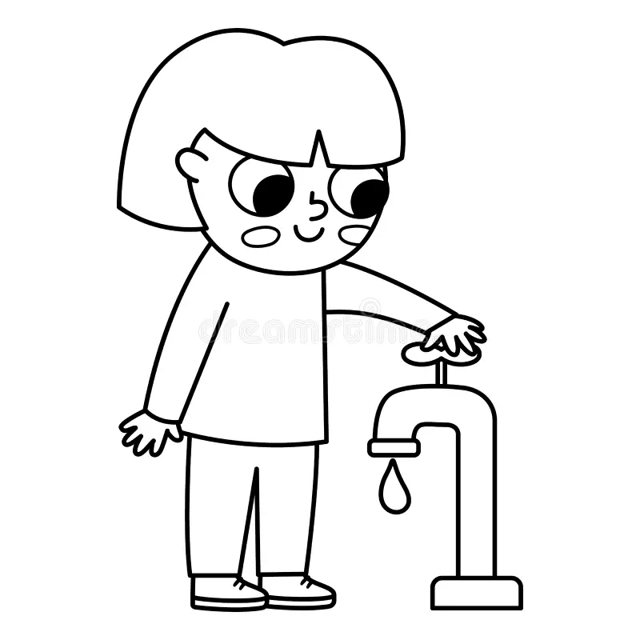
WATER

Slide 7
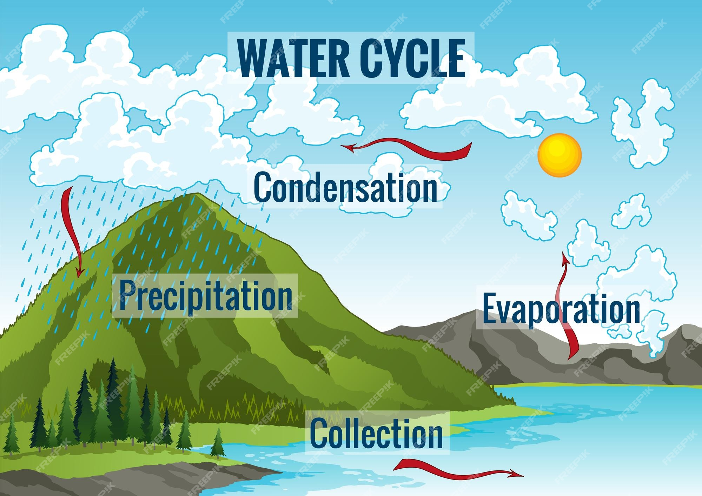
Introduction

Slide 8

Group 1
Colour the rain cloud using pencil colours

Slide 9
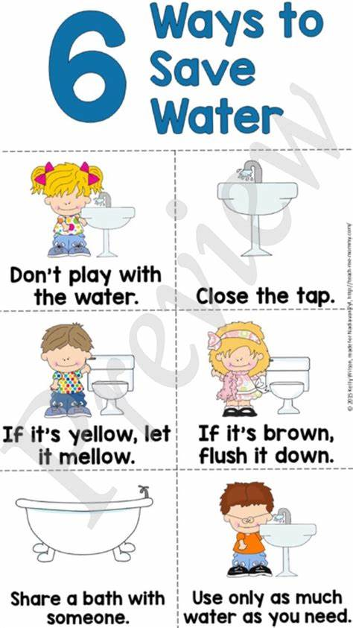
Practical task
HOW TO SAVE WATER

Slide 10
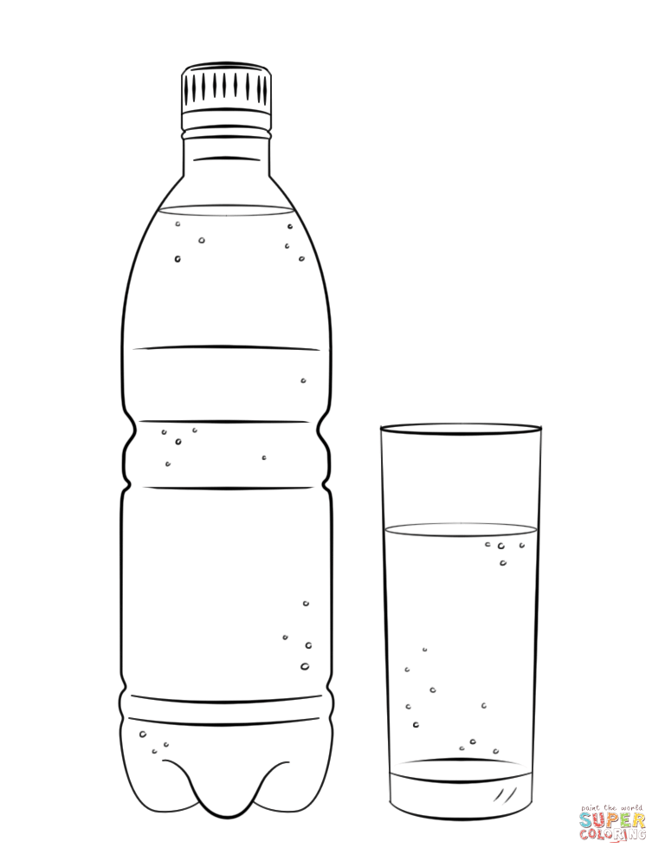
Colour in the water bottle picture below

Slide 11
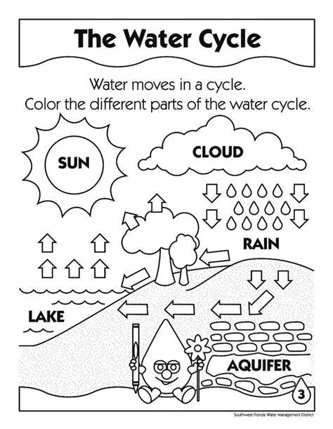
Group 2 water cycle

Slide 12
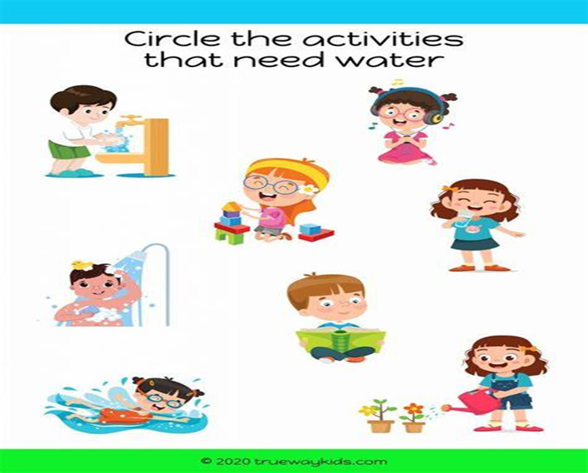

Slide 13
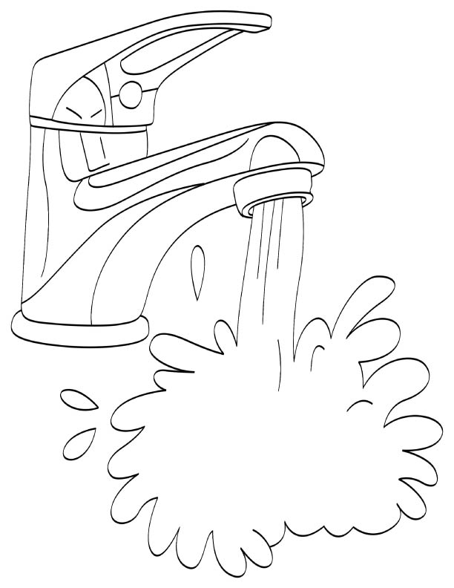
Where do we get water?
Colour the picture below

Slide 14
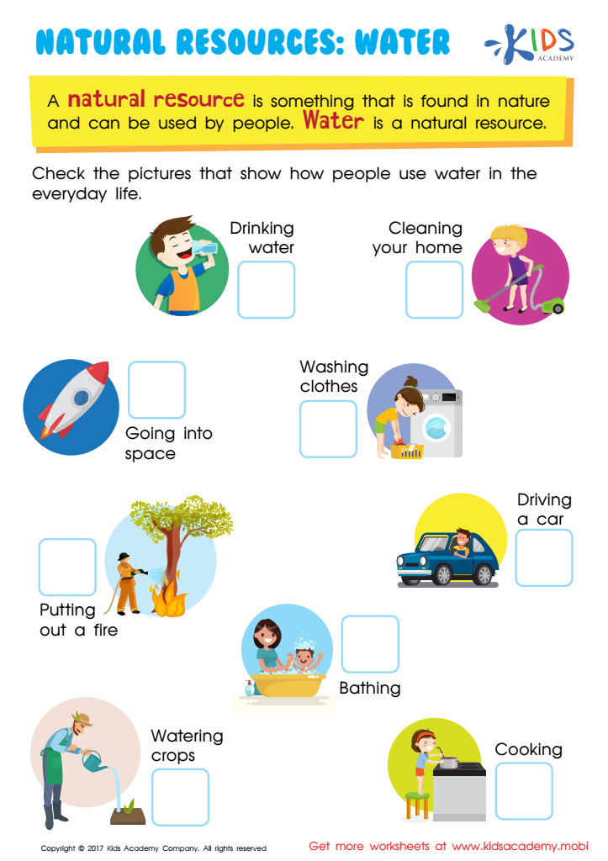
Group 3
Tick the images that shows the ways we use water

Slide 15
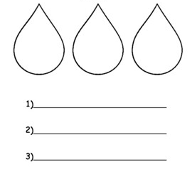
What are the 3 ways you can save water

Slide 16


Slide 17

GROUP 1
Colour the South African flag

Slide 18
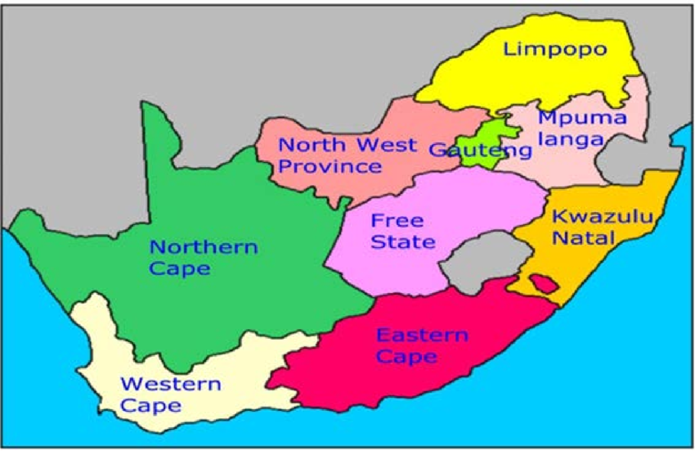
Point out 9 South African provinces

Slide 19

Group 2
Colour the South African flag

Slide 20
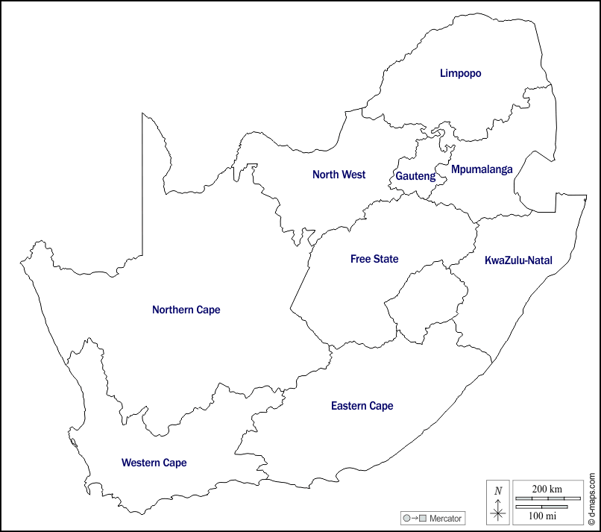
Colour 9 South African provinces

Slide 21
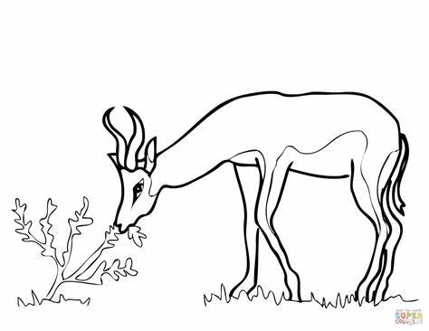
Colour the national springbok

Slide 22

GROUP 3
Colour the South African flag

Slide 23
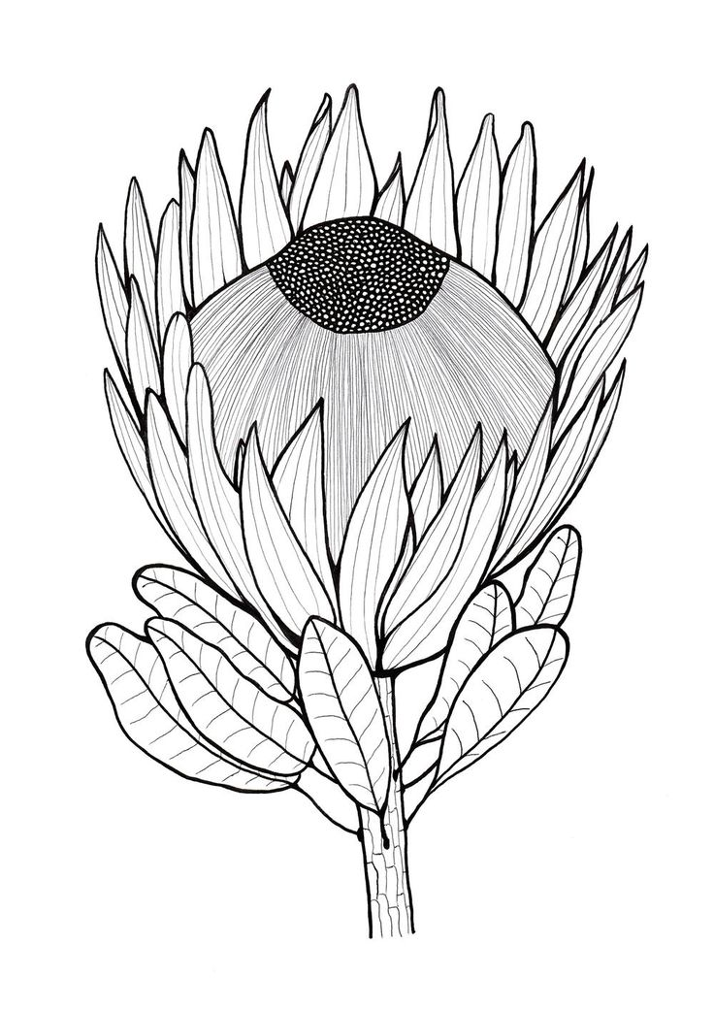
Colour in the protea national flower using different colours

Slide 24
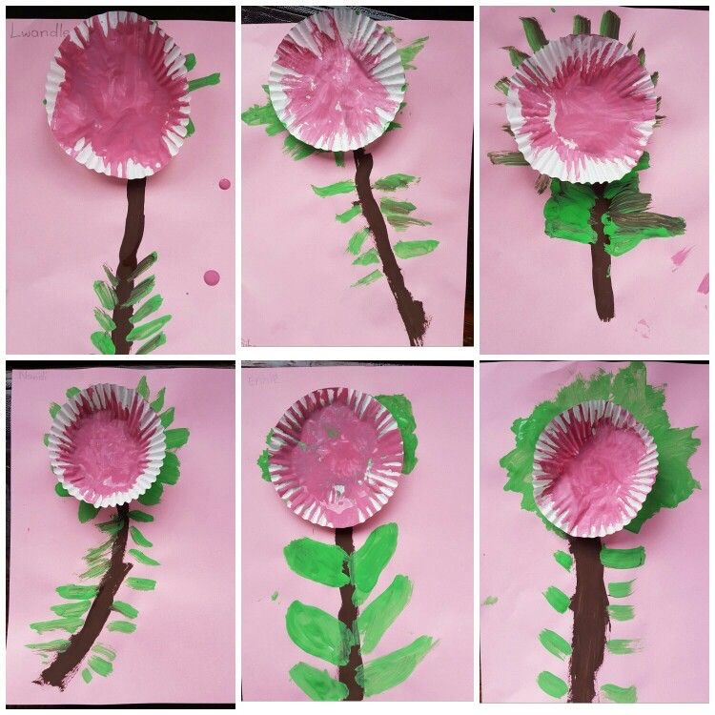
Practical work

Slide 25
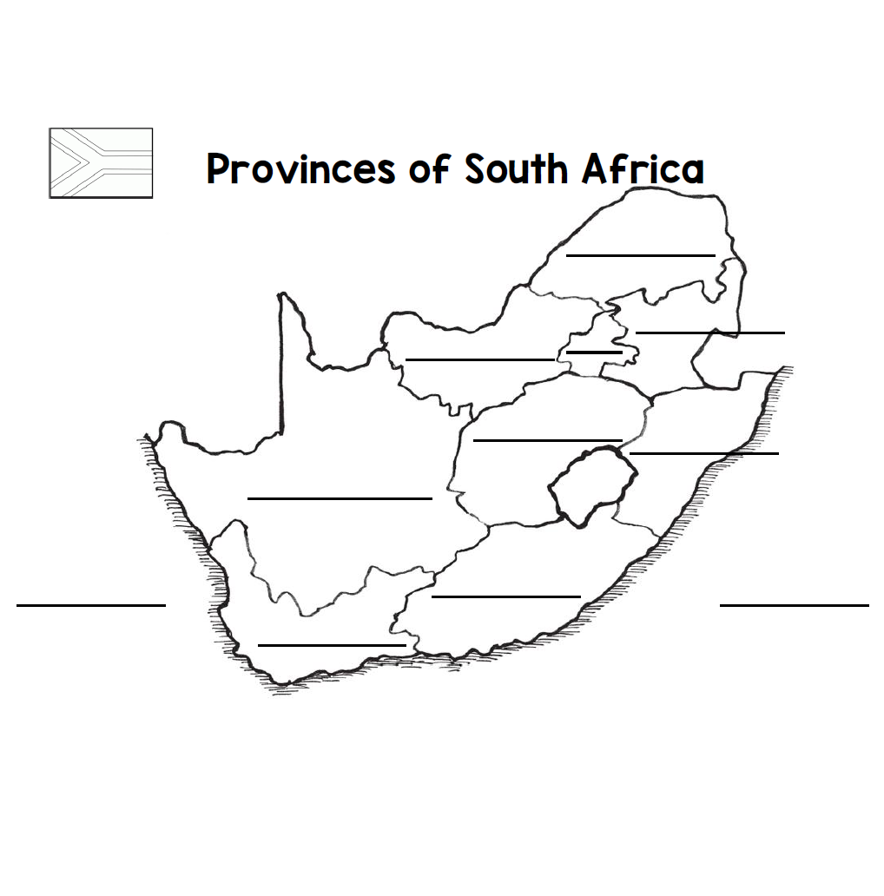
Complete and colour the map

Slide 26
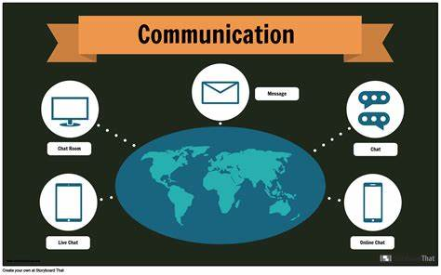
Communication in our world

Slide 27
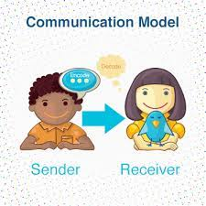
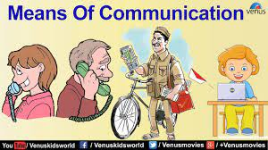
Introduction
What is communication?

Slide 28

Group 1
Colour in the telephone picture

Slide 29
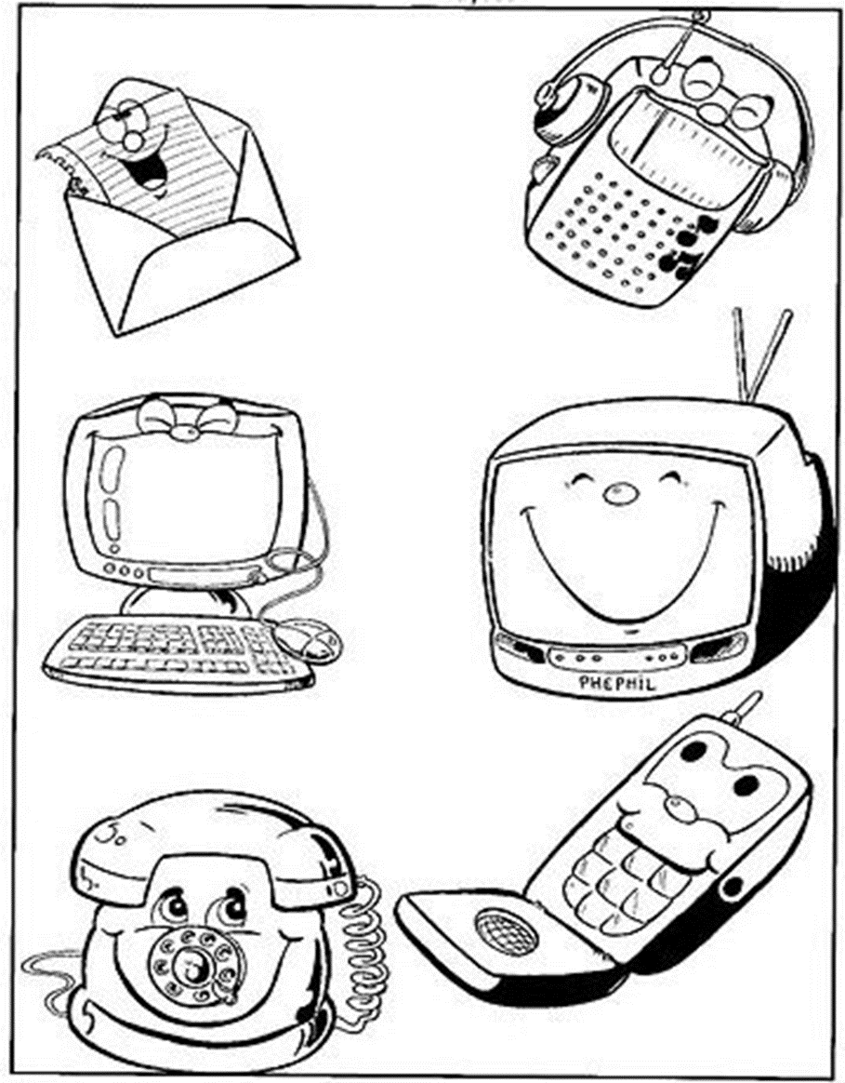
Colour in the picture below

Slide 30
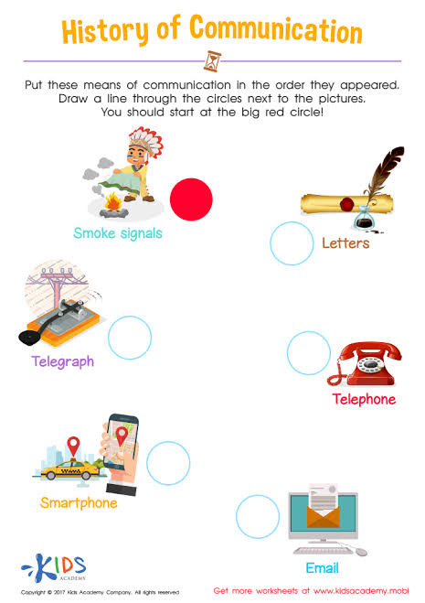
Group 2
Tick the correct form of communication that is used now

Slide 31
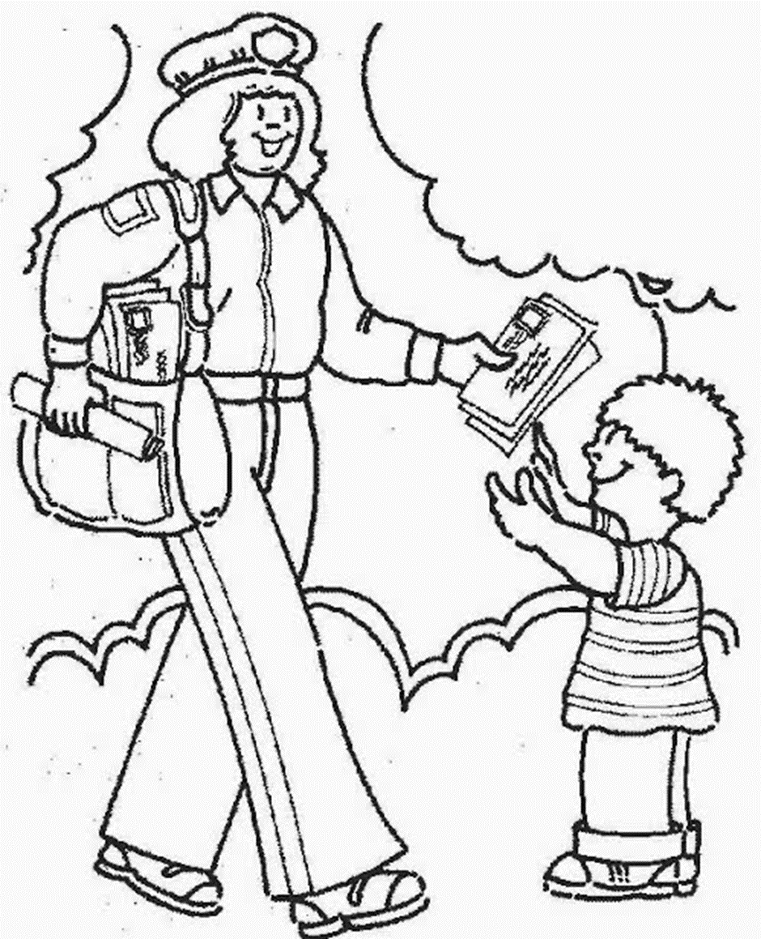
Colour in the mail communication picture below

Slide 32
Group 3
Draw any technology gadget that is used for communication

Slide 33
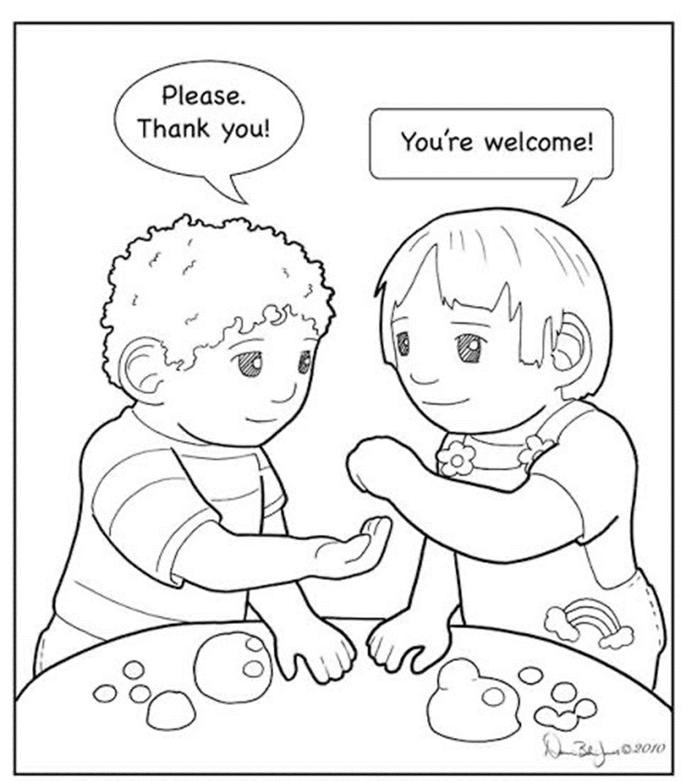
Colour in the picture of verbal communication

Slide 34

Circle the object that we use to communicate

Slide 35
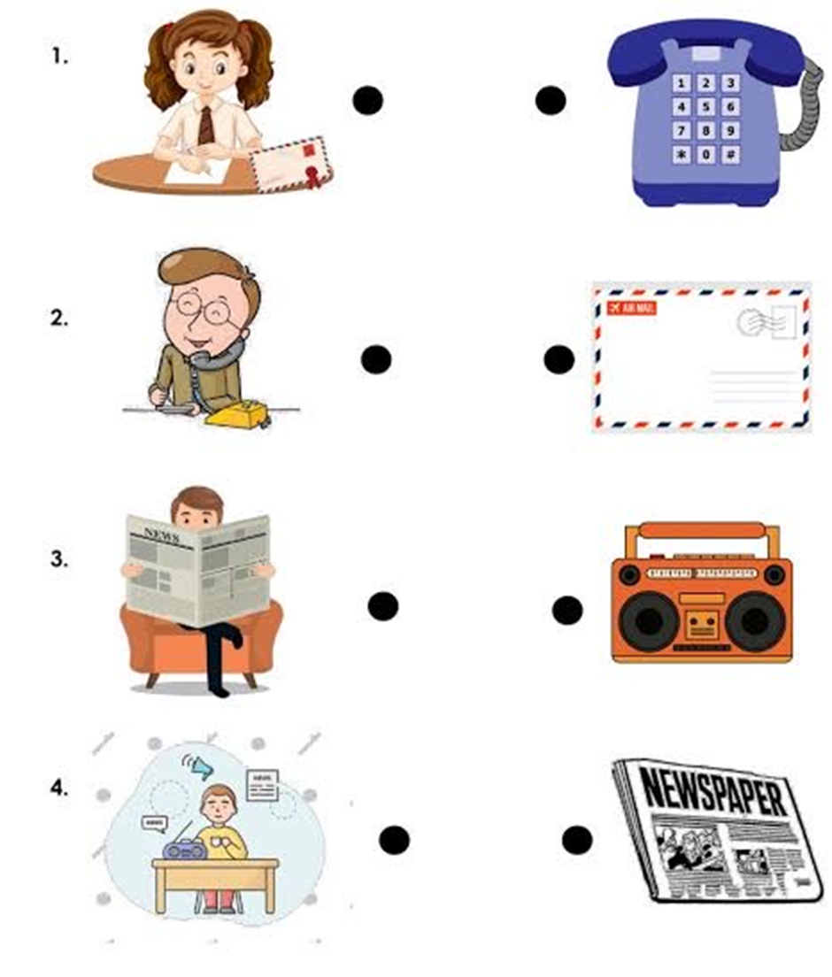
Draw lines to connect the pictures and matching communication tools

Slide 36

LIFE AT NIGHT

Slide 37

GROUP 1
Colour in the moon below

Slide 38

Colour in the star picture below

Slide 39

GROUP 2
Colour in the moon picture below

Slide 40

Trace and colour in the moon picture below

Slide 41
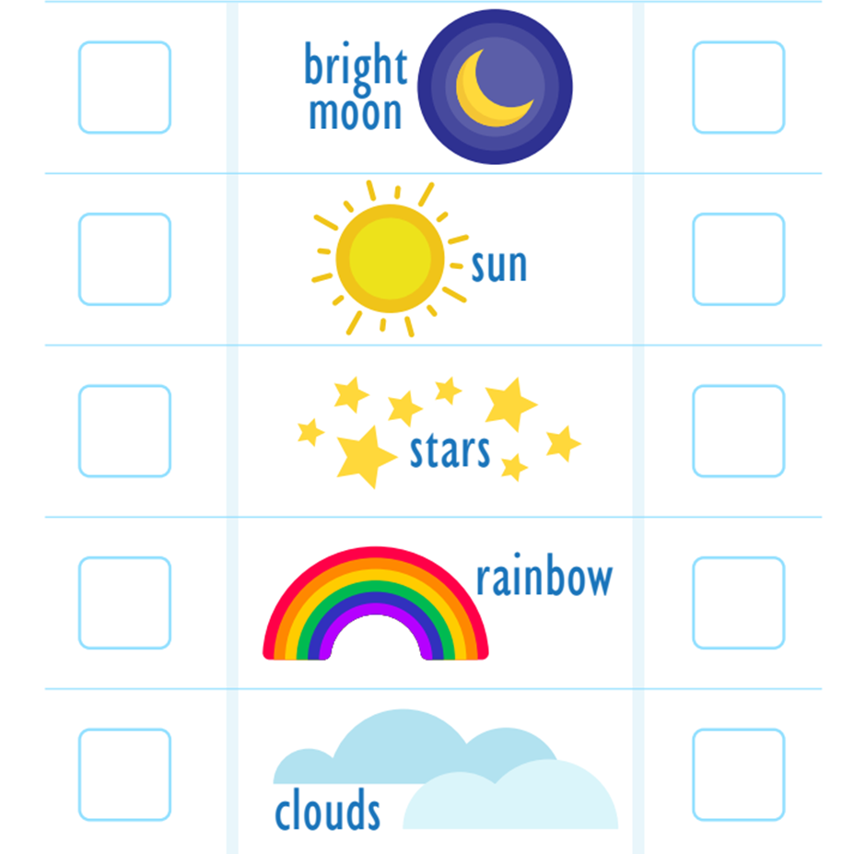
Tick the correct box of what we see at night and during the day

Slide 42
GROUP 3
Draw and colour in any image that represents the night

Slide 43



Colour the images that represent night life

Slide 44
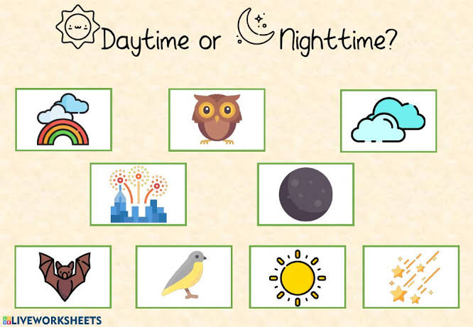
Tick√ the correct picture of night time

Slide 45
REFERENCE LIST

